Slide 1

Digital Performance on a Global Scale Client: Konecranes
iProspect Finland
Terhi Villanova
Senior Performance Marketing Consultant
December 19, 2012

Slide 2
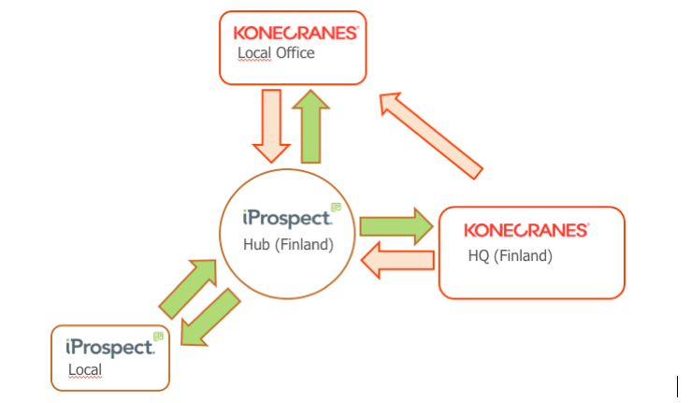
Digital Performance on a Global Scale – Managed Centrally
Consistency across markets
Centralised management brings cost-efficiencies
Learnings shared quickly between countries
Avoiding duplication and cannibalisation

Slide 3
Digital Performance on a Global Scale
Local and Global Paid Search campaigns in 2012
Number of countries is steadily increasing
PPC Campaign | January | February | March | April | May | June | July | August | September | October | November | December
Annual Report (10 market)
Austria
Estonia
Finland (Service)
India
Lithuania
Latvia
Romania
Sweden
Slovenia
Slovakia
CXT (11 markets)
Way Up (5 markets)
Number of Campaigns | 2 | 3 | 3 | 4 | 6 | 7 | 7 | 7 | 7 | 8 | 9 | 12
Annual Report markets -> US, UK, FR, FI, DE, SE, NO, DK, NL, CH.
Way Up markets -> US, UK, FI, AU, IN.
CXT markets -> FI, SE, FR, AT, DE, NO, NL, BE, UK, ES, IT.

Slide 4
Digital Performance on a Global Scale – Local results
Local results from Paid Search campaigns coordinated by iProspect Finland
Country | Timing | Clicks | Impressions | CPC € | PPC / All Traffic | New Visits | View Contact Page (unique) | View Contact Form (unique) | Submitted Contact Us Form
Austria | 2.7. – 11.30.2012 | 6 641 | 162 198 | 0.67 | 35.82% | 81.87% | 427 | 16 | 9
Estonia | 5.7. – 11.30.2012 | 592 | 6 280 | 0.29 | 17.62% | 70.87% | 91 | 11 | 1
Finland (Service) | 1.1. – 11.30.2012 | 2 041 | 10 537 346 | 1.17 | 2.54% | 66.24% | 268 | 36 | 5
India | 6.15. – 8.31.2012 | 2 299 | 127 806 | 0.72 | 16.10% | 85.49% | 408 | 37 | 11
Lithuania | 5.7. – 11.30.2012 | 2 289 | 70 384 | 0.47 | 52.45% | 76.12% | 172 | - | -
Latvia | 5.14. – 11.30.2012 | 2 087 | 48 687 | 0.50 | 58.36% | 80.08% | 56 | 13 | -
Romania | 11.19. – 11.30.2012 | 352 | 6 481 | 0.34 | 71.01% | 90.67% | 16 | 2 | -
Sweden | 3.1. – 11.30.2012 | 1 849 | 76 182 | 1.52 | 11.11% | 77.38% | 203 | 19 | 6
Slovenia | 10.16. – 11.30.2012 | 321 | 7 153 | 0.43 | 57.04% | 87.04% | 57 | 2 | -

Slide 5
Digital Performance on a Global Scale – Happy Global Clients
Comments from the client:
I think we had great results this year – for which I want to wholeheartedly thank all of you since it’s due to your hard work. Like Mikael (the Marketing director) said to me in the beginning of the year when results started to show: “This actually works!” ☺
…due to your good work on these new PPC campaigns and several promising new initiatives..
Once again, it has been a pleasure and I hope to continue our collaboration in 2014 when I come back (from maternity leave) ;)

